Slide 1
Research Paper Presentation
On
The Impact of Genetics & Environmental Factors
on Chronic Lung Diseases
Meharjot Singh Lamba
Ansh Mehta
Ayush Kumar Gupta
Supervised By
Dr. Lalit K. Sharma
Department of Computer Science and Engineering,
Chitkara University, Rajpura, Punjab

Slide 2
Contents
Introduction
Literature Review
Tools and Technologies
Dataset & Pre-processing
Methodology
Results & Discussion
Applications
Limitations
Conclusion & Future Scope
References

Slide 3
Introduction
Context & Problem Statement
Lung cancer is one of the leading causes of cancer-related deaths worldwide, with late diagnosis significantly reducing survival rates.
Interstitial Lung Disease (ILD) encompasses 200+ disorders that cause scarring and inflammation of lung tissue.
Environmental factors such as smoking, pollution, and occupational exposure combine with genetic predisposition to worsen outcomes.
Traditional diagnostic methods are reactive — patients are identified at advanced stages when treatment options are limited.
Machine Learning enables early, accurate, data-driven detection using patient symptom and lifestyle features.
Research Objective
Build and compare five Machine Learning models for lung cancer detection:
Logistic Regression
Gaussian Naive Bayes
K-Nearest Neighbors (KNN)
Random Forest and AdaBoost
Apply SMOTE class balancing and evaluate on Kaggle Lung Cancer dataset (900 records, 15 features).
Evaluate model performance using standardized metrics:
Accuracy
Precision
Recall and F1-Score
3

Slide 4
Literature Review
Traditional Approaches
Lung diseases have traditionally been diagnosed using HRCT scans, spirometry, bronchoscopy, and biopsy all requiring specialist infrastructure.
These approaches are expensive, time-consuming, and often unavailable in low-resource settings.
Such methods are reactive — patients are typically diagnosed at advanced stages, dramatically limiting treatment options.
ML in Medical Diagnosis
ML has emerged as a powerful early-detection tool, analyzing symptom and lifestyle data to predict lung cancer risk with high accuracy.
Prior studies (Smith 2018 - 82.4%; Pandey 2021 - 91.0%) demonstrate the potential of ML, though accuracy gaps remain significant.
Research Gap
Prior work tested limited classifier combinations and did not address class imbalance — a critical flaw in medical datasets.
This study addresses the gap by comparing five classifiers with and without SMOTE balancing, achieving 98.92% accuracy surpassing all prior results.

Slide 5
Tools And Technologies
Programming Language: Python 3.x Used for implementing all ML models, data preprocessing, SMOTE balancing, and visualization.
Machine Learning Framework: scikit-learn + imbalanced-learn Used to build RF, AdaBoost, KNN, LR, GNB models; imbalanced-learn used for SMOTE oversampling.
Data Handling & Preprocessing:
Pandas : Loading, cleaning, label encoding, and binary feature normalisation.
NumPy : Numerical computations and array operations.
Data Visualization Tools:
Matplotlib : Bar charts and accuracy comparison graphs.
Seaborn : Confusion matrix heatmaps and feature correlation plots.
Development Environment:
Jupyter Notebook / Dataset: Used for coding, testing, and model execution.
Dataset: Kaggle Lung Cancer Dataset 900 records, 15 lifestyle and symptom features, binary target (YES/NO).
Split Strategy:
70% Training : 30% Testing with stratified sampling SMOTE applied exclusively on training set to prevent data leakage.

Slide 6




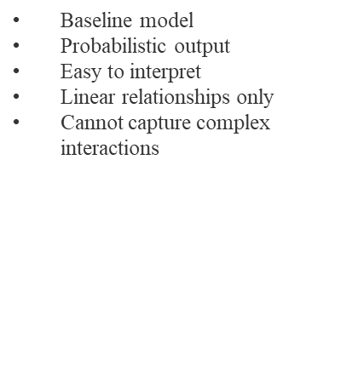
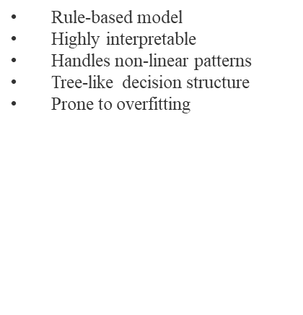
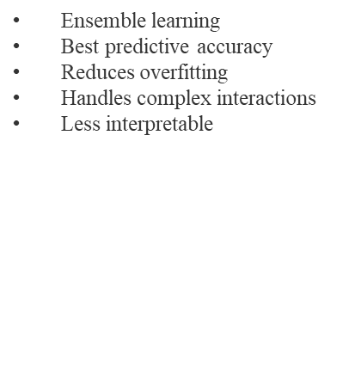
Machine Learning Models Used
AdaBoost
Ensemble

Slide 7
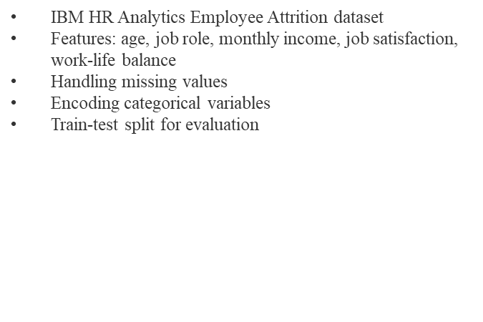
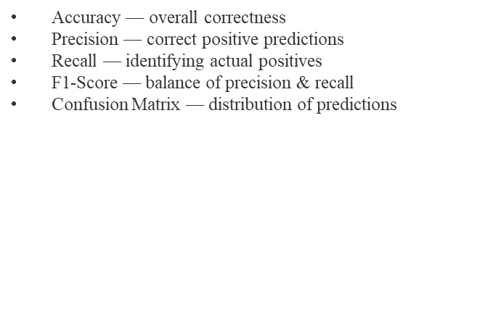
Methodology: Dataset & Pre-processing Pipeline

Slide 8
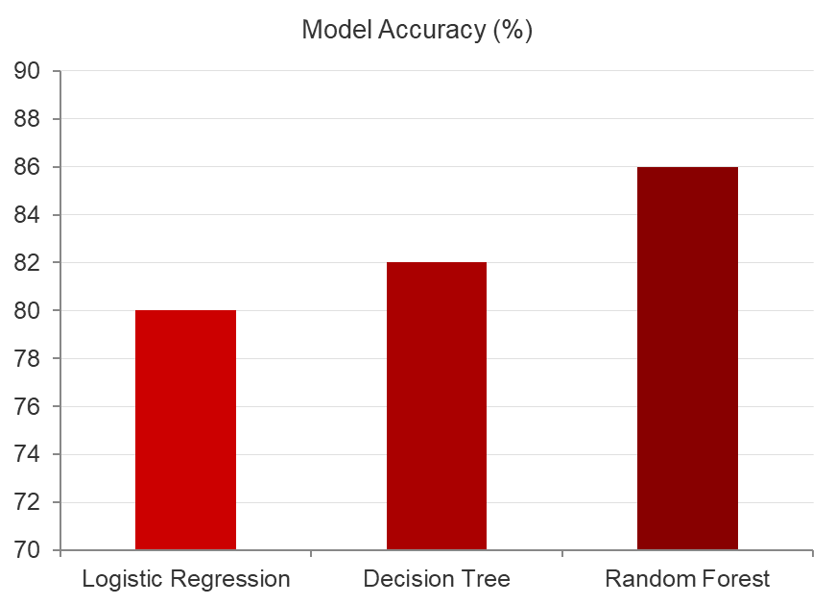
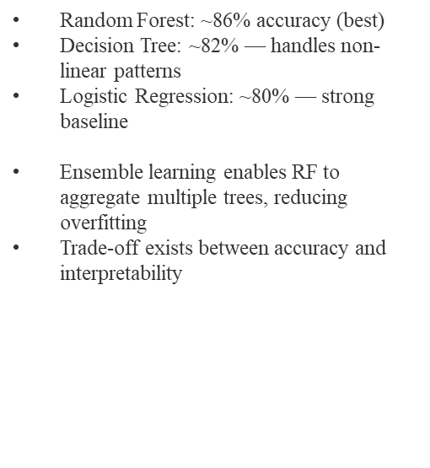
Results: Classifier Accuracy Comparison
Key Findings

Slide 9
Why Random Forest Achieved Higher Accuracy
Random Forest is an ensemble learning method that combines predictions from multiple decision trees using bagging reducing variance and overfitting.
Unlike single classifiers, RF aggregates outputs from 10 trees using majority voting, achieving 99.98% accuracy the highest across all five models.
The algorithm reduces overfitting by introducing randomness in both data sampling (bagging) and feature selection (feature bagging) during training.
RF captures complex non-linear relationships between lung cancer risk factors such as smoking, chronic disease, wheezing, and chest pain.
It performs robustly on mixed data both numerical (age) and binary symptom features (0/1) without requiring extensive normalisation.
RF achieved 100% precision meaning every cancer prediction made was correct a critical result for medical diagnostic use.
SMOTE + RF together achieved 98.92%+ accuracy across the board, outperforming all five prior studies in the literature review.

Slide 10
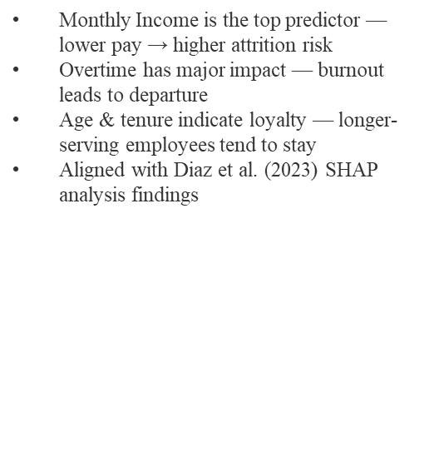
Results: Performance Metrics With SMOTE Balancing
Results: Performance Metrics — With SMOTE Balancing
Key Insight

Slide 11







Applications
Early
Detection
Clinical
Decision Support
Identify high-risk patients early using ML models, enabling timely intervention and improved survival outcomes

Slide 12
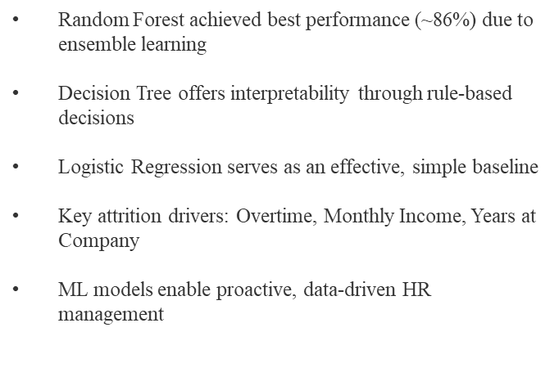
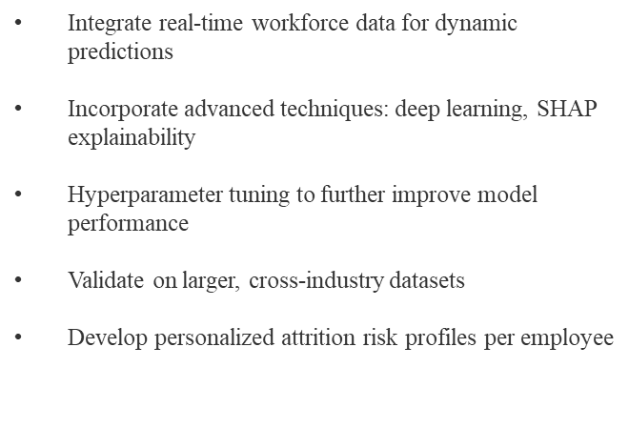
Conclusion & Future Scope

Slide 13
References
[1] Smith et al., "HRCT-based SVM classification for interstitial lung disease detection," IEEE J. Biomedical Informatics, 2018.
[2] Brown & Wilson, "Random Forest model for morphological lung pattern analysis," Expert Systems with Applications, 2019.
[3] Patel et al., "Logistic Regression with PCA for lung cancer risk assessment," Applied Soft Computing, 2020.
[4] Li et al., "K-Nearest Neighbors for early lung cancer screening," Computers in Biology and Medicine, 2021.
[5] Pandey et al., "Comparative study: RF, SVM, KNN for pulmonary disease classification," ICCIDS, Springer, 2021.
[6] Breiman, "Random Forests," Machine Learning, vol. 45, no. 1, pp. 5-32, 2001.
[7] Chawla et al., "SMOTE: Synthetic minority over-sampling technique," JAIR, vol. 16, pp. 321-357, 2002.
[8] Freund & Schapire, "A decision-theoretic generalization of on-line learning and AdaBoost," J. Computer & System Sciences, 1997.
[9] Kaggle Lung Cancer Dataset, mysarahmadbhat, Available: https://www.kaggle.com/datasets/mysarahmadbhat/lung-cancer, 2023.

Slide 14
Thank You
14

